Slide 1





University of Prince Mugrin
College of Computer & Cyber Sciences
Department of Artificial Intelligence
Usability Testing Analysis with Mouse Tracking
and Facial Expressions
AI 385 – Computer Vision
Team Members:
Jana Aldubai – 4010372
Salwa Shamma – 4010405
Samah Shamma – 4010403
Sana Shamma – 4010404
Instructor:
Dr. Ahmed Elhayek
Ms. Reem Aljuhani
Academic Year 2023 – 2024

Slide 2

Table of Contents
Introduction
Algorithm 1: Mouse Tracking
Algorithm 2: Facial Expressions
Use Case Scenario & System Output
Conclusion
02

Slide 3



Introduction
What is usability testing and what is its purpose?
How is usability testing conducted?
What challenges can arise during usability testing?
Usability testing is a method used to evaluate how easy the software application is to use.
Creating specific tasks for users to perform while interacting with the system.
Subjective measure, can we SUPPORT it with DATA?!
03

Slide 4



Solutions
01
Mouse Tracking
02
Facial Expressions
04

Slide 5




Method
Algorithm 1: Mouse Tracking
The algorithm consists of 5 straightforward steps
Collect mouse positions at regular intervals.
Store them in a file.
Convert them into white dots in an image with a black background.
Compare the user-tracked path with a standard path by applying the XOR operation.
Compute the percentage of mismatches to indicate the system's usability.
05

Slide 6
Method
Algorithm 2: Emotion Detection
STEP 01
Pre-processing
STEP 02
Emotion Detection
STEP 03
Result Formatting
06

Slide 7
Method
Algorithm 2: Emotion Detection
Convert the frame to grayscale.
Detect faces in the grayscale frame.
Crop the face region.
Step 1: Preprocessing
Pre-trained Model: Haar cascade classifier
07

Slide 8
Method
Algorithm 2: Emotion Detection
Detect emotions from the cropped face.
Step 2: Emotion Detection
Pre-trained Model: FER Model
Black Box Model
(Emotion Detection)
Output:
Seven Emotions With their Probabilities
Input:
Frame with Cropped Face
08

Slide 9
Method
Algorithm 2: Emotion Detection
Frame emotion determination based on highest probability
Classify the motion into usability level (easy, hard).
Determine overall usability determination (Most apparent usability level)
Step 3: Result Formatting
09

Slide 10

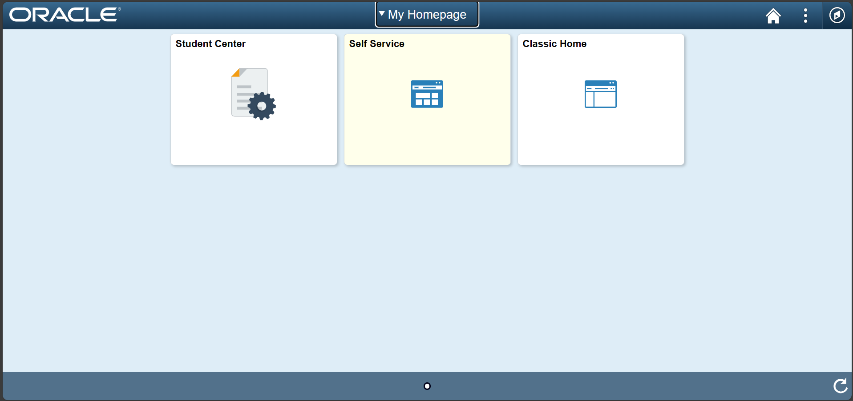
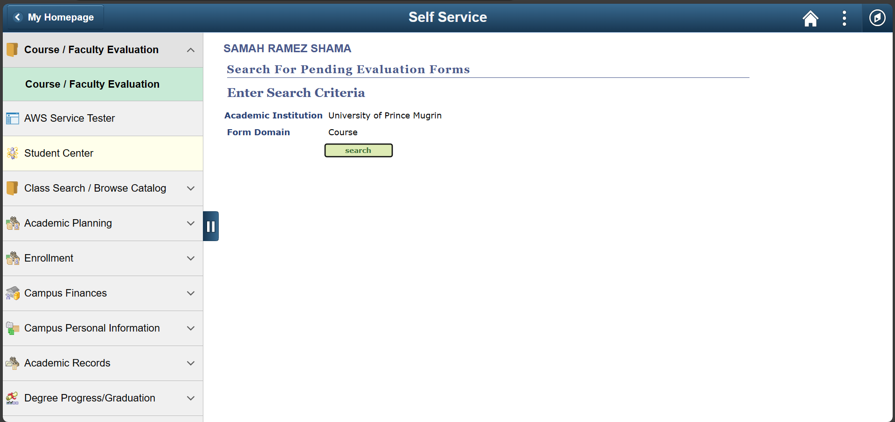
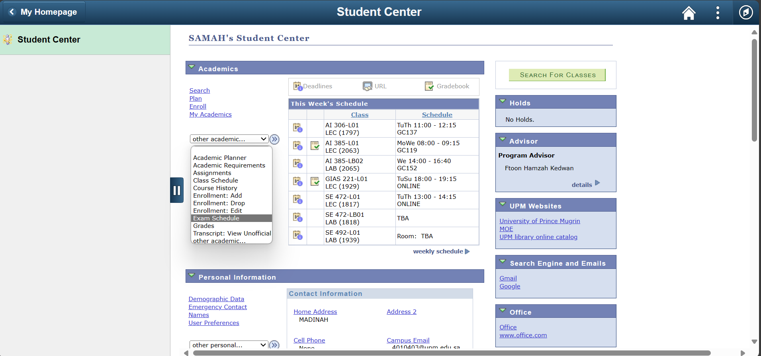
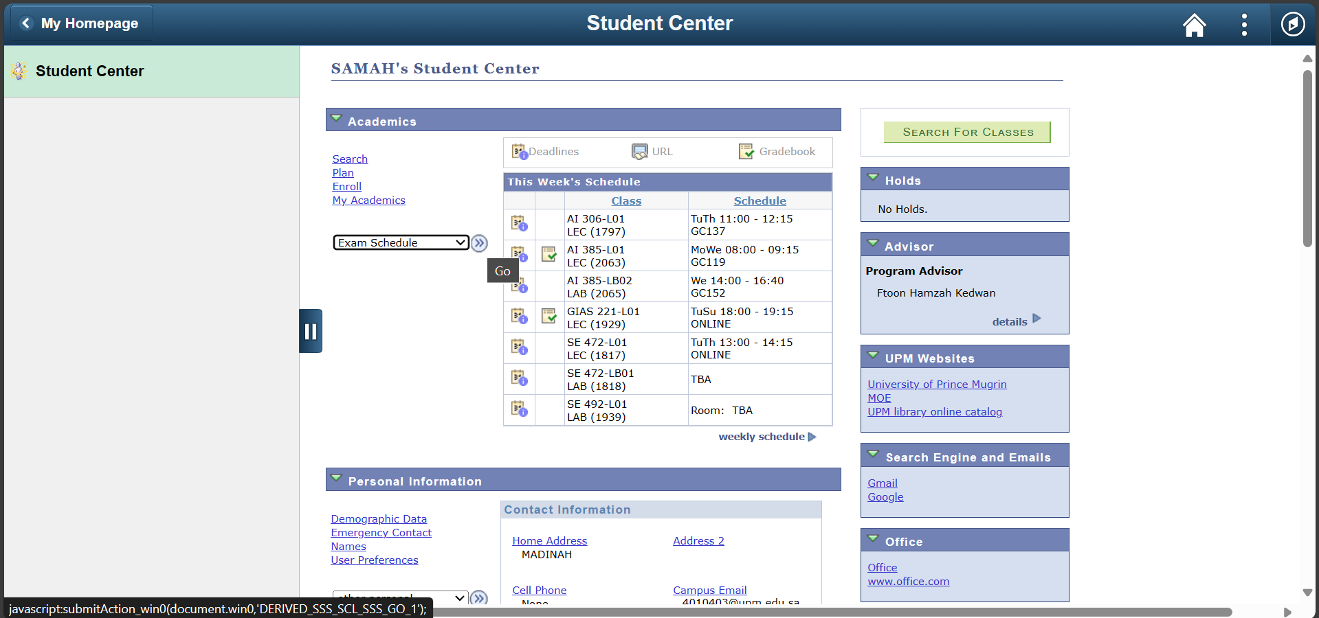
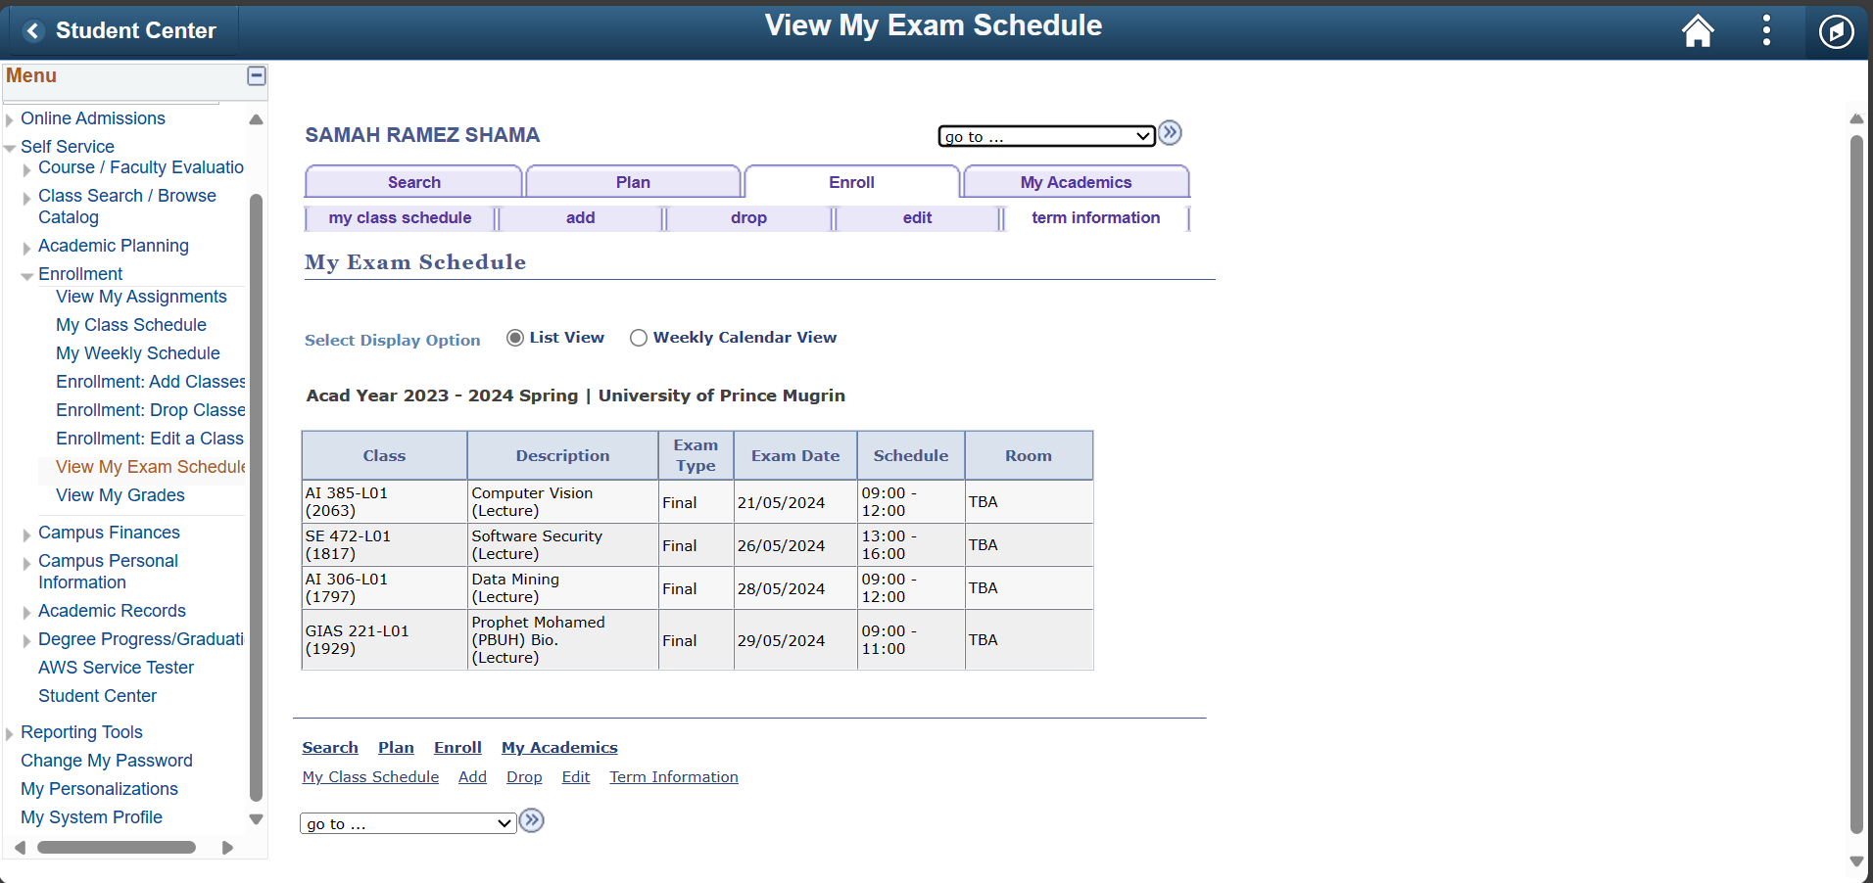
Use Case Scenario
Steps to access the final exam schedule in the SIS:
Login into the system
Self-service
Student Center
Using the dropdown list
Choose Exam schedule.
10

Slide 11
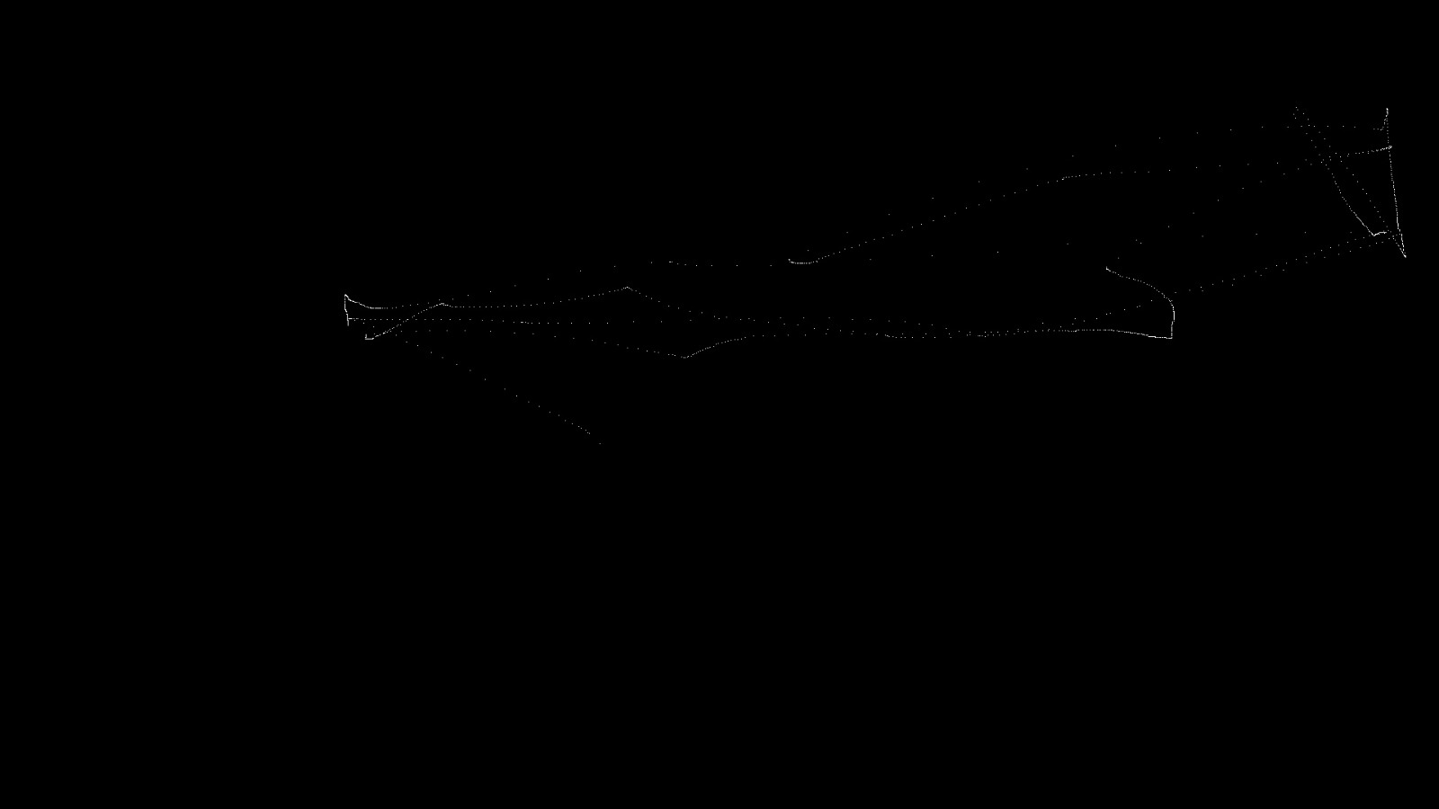
System Output
Algorithm 1: Mouse Tracking
Input: Reference path.
11

Slide 12
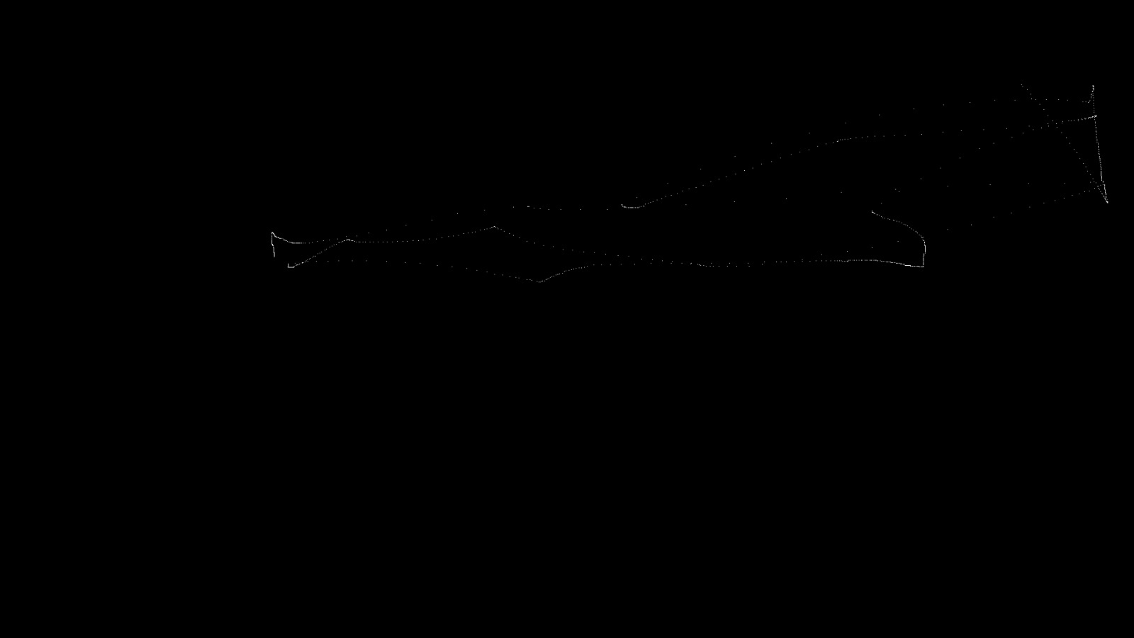
System Output
Algorithm 1: Mouse Tracking
Input: Reference path & User’s path
12

Slide 13
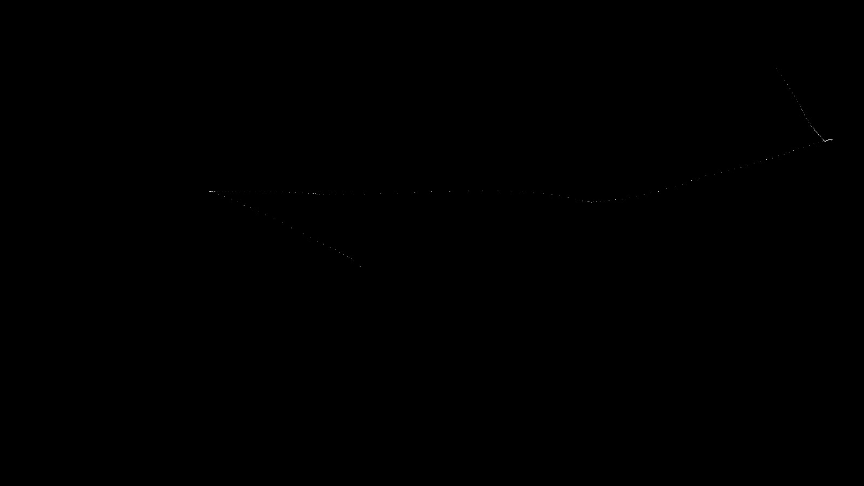
System Output
Algorithm 1: Mouse Tracking
Input: Reference path & User’s path
Output:
Display dissimilarity paths
XOR output
13

Slide 14
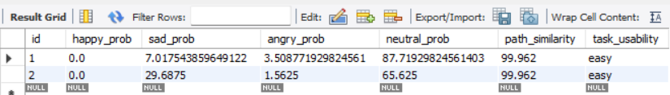
System Output
Algorithm 1: Mouse Tracking
Input: Reference path & User’s path
Output:
Display dissimilarity paths
XOR output
The usability of the system depend on the dissimilarity paths and user’s emotion.
14

Slide 15
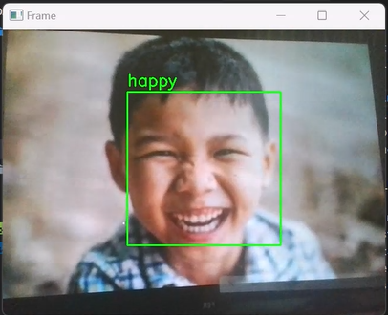
System Output
Algorithm 2: Facial Expressions
Displaying the video stream in real-time, highlighting detected faces and labeling their emotions.
15

Slide 16
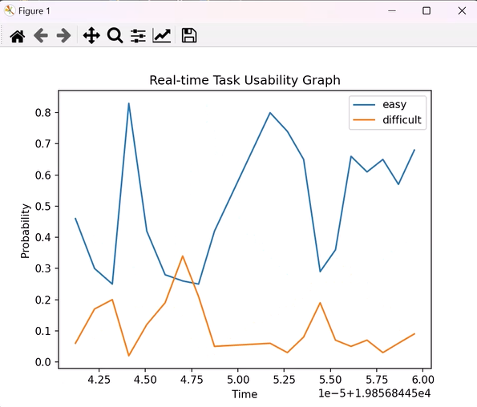
System Output
Algorithm 2: Facial Expressions
Displaying the video stream in real-time, highlighting detected faces and labeling their emotions.
Real-time plot showing the difficulty of the task.
16

Slide 17
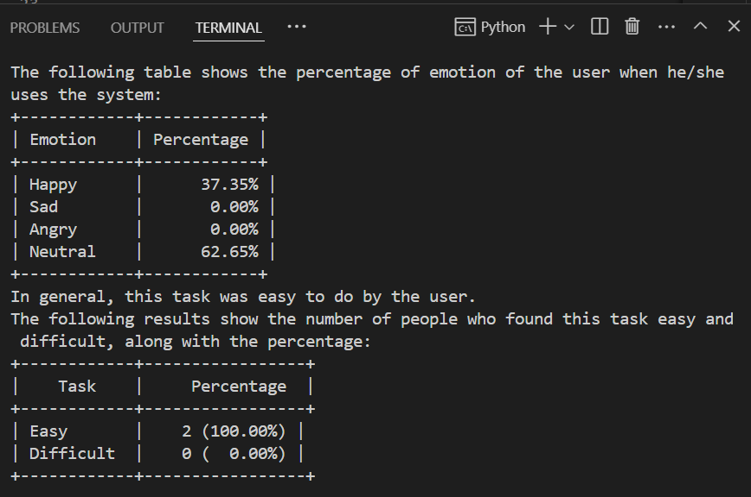
System Output
Algorithm 2: Facial Expressions
Displaying the video stream in real-time, highlighting detected faces and labeling their emotions.
Real-time plot showing the difficulty of the task.
Display some statistics:
The percentages of happy, sad, angry, and neutral emotions over a specific period of time for a specific user.
17

Slide 18
System Output
Algorithm 2: Facial Expressions
Displaying the video stream in real-time, highlighting detected faces and labeling their emotions.
Real-time plot showing the difficulty of the task.
Display some statistics:
The percentages of happy, sad, angry, and neutral emotions over a specific period of time for a specific user.
The result of how difficult the task is [easy, difficult] for a specific user.
18

Slide 19
System Output
Algorithm 2: Facial Expressions
Displaying the video stream in real-time, highlighting detected faces and labeling their emotions.
Real-time plot showing the difficulty of the task.
Display some statistics:
The percentages of happy, sad, angry, and neutral emotions over a specific period of time for a specific user.
The result of how difficult the task is [easy, difficult] for a specific user.
Totalling the number of users finding the task [easy, difficult].
19

Slide 20
Conclusion
The Conclusion Of Presentation
Applied computer vision knowledge to the project by utilizing various techniques and concepts.
Developed an useful solution using mouse tracking and emotion detection.
20

Slide 21
THANKS
FOR YOUR ATTENTION

